Slide 1

TOP SHOP MANAGEMENT SYSTEM
BY AHMED ALI ANSARI (1402-2020)
INSTRUCTOR : SIR MUHAMMAD NAQQASH
COURSE : DATABASE MANAGEMENT SYSTEM (LAB)
DATE : 6/22/2022

Slide 2

HISTORY OF DATABASE
The concept of a database existed long before computers. In these times, data was stored in journals, in libraries, and in hundreds of filing cabinets. Everything was recorded via paper — and that meant it took up space, was hard to find, and difficult to back up.
And then computers became available, and with them, the opportunity for better data management.

Slide 3
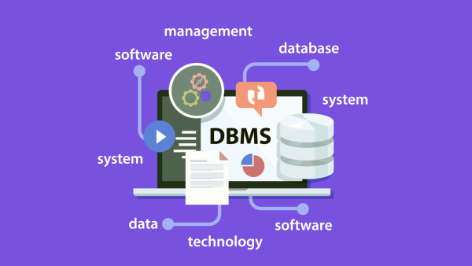
HISTORY OF DBMS
Charles Bachman was the first person to develop the Integrated Data Store (IDS) which was based on network data model for which he was inaugurated with the Turing Award (The most prestigious award which is equivalent to Nobel prize in the field of Computer Science.). It was developed in early 1960’s.

Slide 4

DEFINITION OF DBMS
A database management system (DBMS) is system software for creating and managing databases. A DBMS makes it possible for end users to create, protect, read, update and delete data in a database.

Slide 5
TOP SHOP (B TO B) & (B TO C) ONLINE STORE
ER DIAGRAM OF TOPSHOP MANAGEMENT SYSTEM

Slide 6
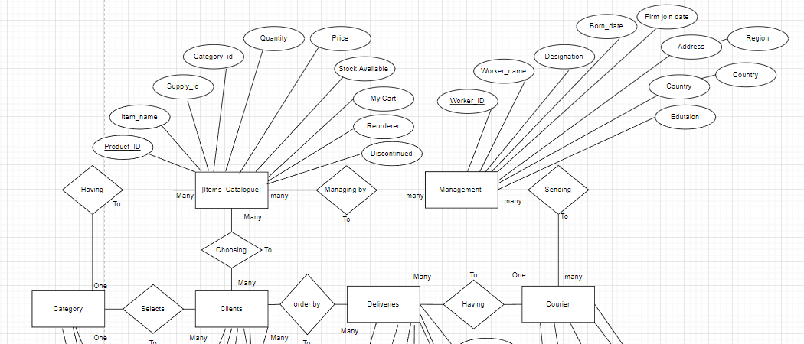

Slide 7
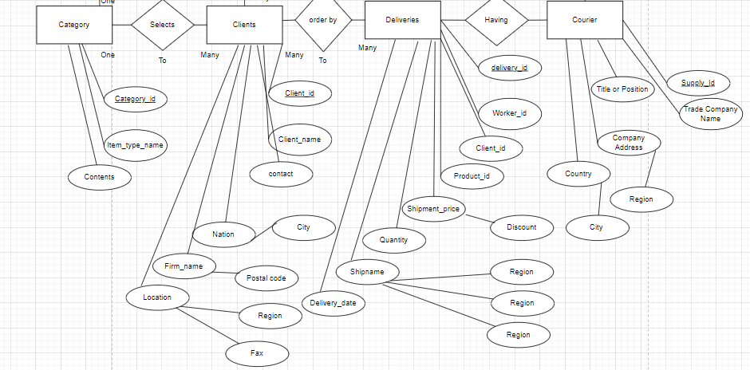

Slide 8
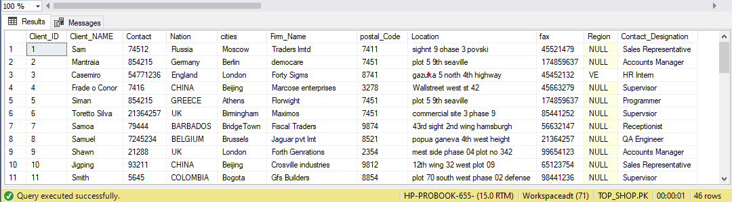
TOP SHOP (B TO B) & (B TO C) ONLINE STORE
DATABASE CONSIST OF TOTAL 06 TABLES
TABLE # 01 ( Clients )

Slide 9
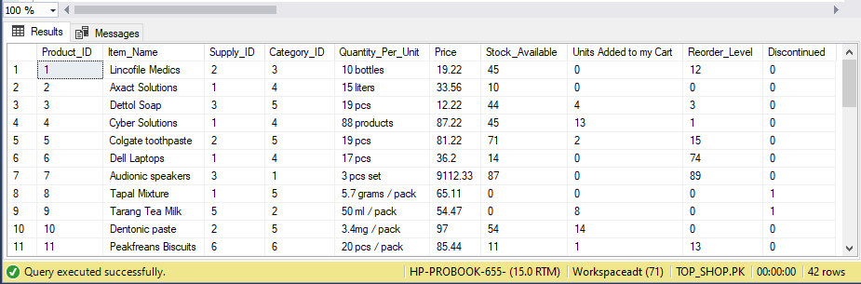
TOP SHOP (B TO B) & (B TO C) ONLINE STORE
DATABASE CONSIST OF TOTAL 06 TABLES
TABLE # 02 ( Items_Catalogue )

Slide 10
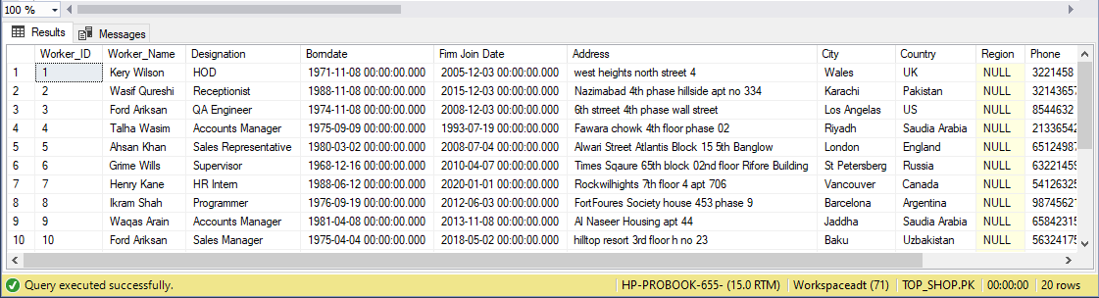
TOP SHOP (B TO B) & (B TO C) ONLINE STORE
DATABASE CONSIST OF TOTAL 06 TABLES
TABLE # 03 ( MANAGEMENT )

Slide 11
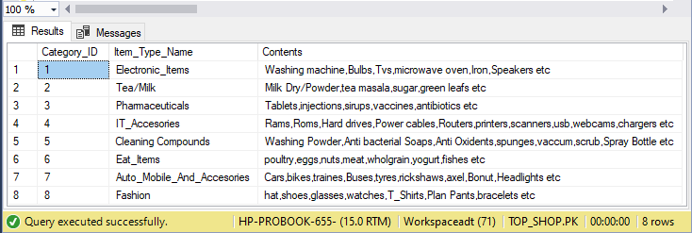
TOP SHOP (B TO B) & (B TO C) ONLINE STORE
DATABASE CONSIST OF TOTAL 06 TABLES
TABLE # 04 ( Category )

Slide 12
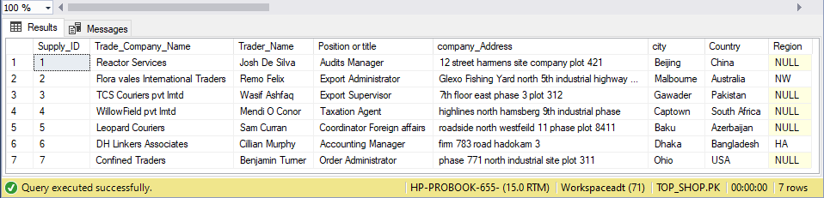
TOP SHOP (B TO B) & (B TO C) ONLINE STORE
DATABASE CONSIST OF TOTAL 06 TABLES
TABLE # 05 ( Courier )

Slide 13
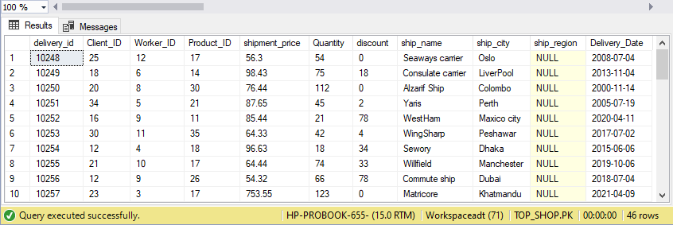
TOP SHOP (B TO B) & (B TO C) ONLINE STORE
DATABASE CONSIST OF TOTAL 06 TABLES
TABLE # 06 ( Deliveries )

Slide 14
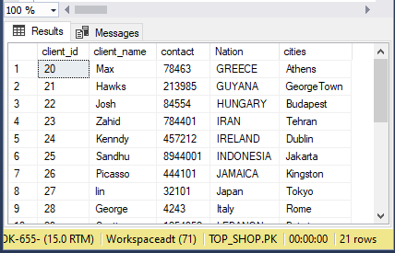
QUERIEs
Question : Display the records from customers table ranging Customers ids from 20 to 40.
Query : select client_id,client_name,contact,Nation,cities from clients where client_ID between 20 and 40

Slide 15
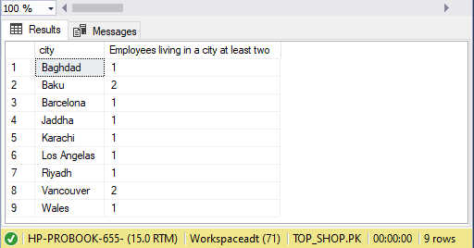
QUERIEs
Question : Retrieve the number of employees in each city in which there are at least 2 employees.
Query : select city,count(city) as [Employees living in a city at least two] from management where city in (select city from management group by city having count(city)<=2 ) group by city

Slide 16
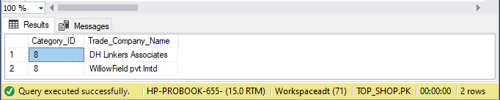
QUERIEs
Question : Create a report that shows all companies by name that sell products in CategoryID 8. (Tables : Supplier & Products)
Query : select [Items_Catalogue].Category_ID,courier.Trade_Company_Name from [Items_Catalogue] join courier on ([Items_Catalogue].supply_id= courier.supply_id) where Category_ID = 8 group by [Items_Catalogue].Category_ID,courier.Trade_Company_Name

Slide 17
DATABASE MANAGEMENT SYSTEM
ADVANTAGES
DisADVANTAGES
Controls database redundancy: All the data is stored in one place, and that recorded in the database and hence controls the redundancy in the database.
Data sharing: DBMS allows users with authority to share the data in the database with multiple users.
Easy Maintenance: The centralized nature of the database helps in the easy maintenance of the data.
Multiple user interfaces: It offers a number of user interface to multiple users.
Cost of software and hardware: It requires a number of high powered processors and large size memory to run DBMS.
Size: a Large amount of storage size is required to run DBMS efficiently.
Complexity: DBMS adds an additional layer of complexity to the data.
Higher impact of failure: DBMS faces a higher risk of losing the data since all the data is stored at a single location and a catastrophic failure can wipe it all.

Slide 18
DATABASE MANAGEMENT SYSTEM
APPLICATIONS
Railway Reservation System − The railway reservation system database plays a very important role by keeping record of ticket booking
Library Management System − Now-a-days it’s become easy in the Library to track each book and maintain it because of the database.
Banking − Banking is one of the main applications of databases. We all know there will be a thousand transactions through banks daily and we are doing this without going to the bank.
Social Media Sites − By filling the required details we are able to access social media platforms. Many users sign up daily on social websites such as Facebook, Pinterest and Instagram. All the information related to the users are stored and maintained with the help of DBMS.

Slide 19

THANKYOU

